Slide 1
Creating Optimal Lineups for DraftKings MLB

Slide 2
Problem Statement
Use Data Science to attempt to improve my odds when participating in DraftKings contests
Create models to predict player scores
Create a lineup generator to make lineups that are expected to succeed based on their predicted score.
By submitting a large number of lineups I hope to increase my chances of being profitable

Slide 3
Data
Player cumulative stats were taken from fangraphs and include stats from the 2020 and 2021 seasons
Past DraftKings performance was taken daily from Rotogrinders.com
Daily baseball lineups were downloaded from Baseballmonster.com
Pitchers and Batters are scored differently so the predictions for those players were modeled and analyzed separately

Slide 4
Important Terms
DraftKings Salary – Number assigned by DraftKings to each baseball player, representing their expected value. DK Users have $50,000 worth of salary to create lineups of players.
DraftKings Points – A score calculated based on a baseball players performance in that day’s game. The lineups with the largest total score are paid according to a pay scale defined by each contest.

Slide 5
DraftKings Scoring Breakdown

Slide 6
Distribution of batter scores

Slide 7
Distribution of pitcher scores

Slide 8
Top feature correlations for batters

Slide 9
Top feature correlations for pitchers

Slide 10
Batter Model
Fit an ARIMA model on each player to predict the next games score
Used an order of (0,1,1)
Mean AIC is 315
This model is able to pick up on trends while mostly staying near each individual players’ mean points scored

Slide 11
Pitcher model
Used a neural network to predict player scores based on their stats and the teams they were against
Root Mean Squared Error: 11
Averaged predictions with pitchers’ average DraftKings points for final prediction.

Slide 12
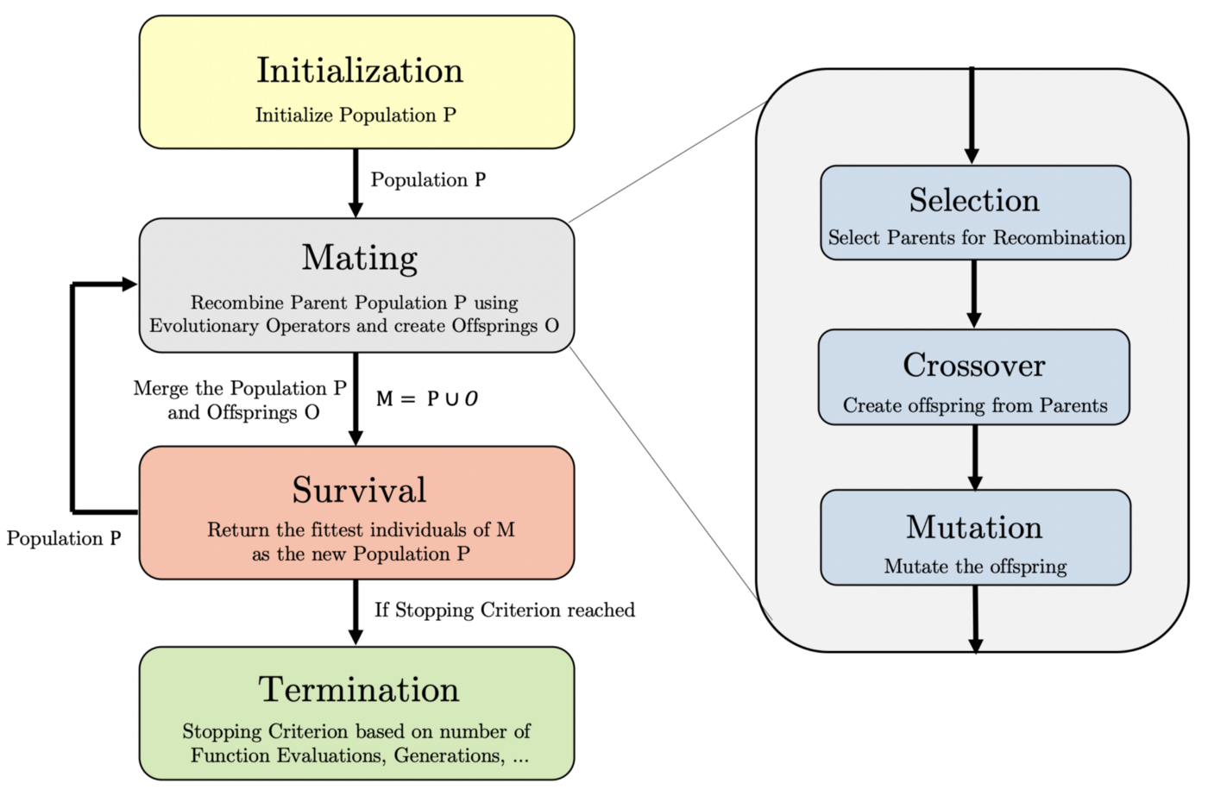
Generating Lineups using a Genetic Algorithm

Slide 13
I was able to use this technique to make a very small profit
 | 7/2 | 7/3 | 7/4 | 7/5 | Total
Entry Cost | $73.50 | $75 | $73 | $75 | $296.50
Winnings | $123 | $12.50 | $115.50 | $49.50 | $300.50
Profit | + $49.50 | - $62.50 | + $42.50 | - $25.50 | + $4

Slide 14
Conclusions
Though I am currently profitable, I do not believe that my model will be consistently profitable without making some changes
Predicting scores accurately is less important to consistent success than proper lineup generation
My current technique allows for me to be too reliant on an individual player having a strong game
No matter how much data science is behind my predictions, it’s still gambling

Slide 15
Limitations
I had to find and merge data from many sources
Predicting stats on a game by game basis is always going to be incredibly difficult
Testing my lineups costs money and could be expensive over time
I don’t have a long testing period to make strong conclusions about the current strength of my methods

Slide 16
Next Steps
Learn more about genetic algorithms to apply new methods to my lineup creation
View the accounts of top performing DraftKings players to try to see their strategies when forming lineups
Continue submitting lineups to see where my strategies fail
Gather more data to improve my model’s predictive strength

